Slide 1



BLOOD MONEY
THE WEAPONIZATION
OF
PUBLIC HEALTH
Facilitation Method for Global Depopulation
TODD S. CALLENDER, ESQ.
LTC (RET) PETE CHAMBERS, D.O.

Slide 2
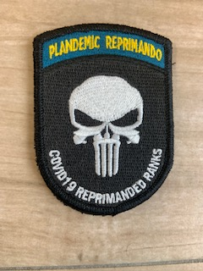
Todd S. Callender, Esq.
~ Juris Doctor – University of Denver
~ Licensed in Colorado Supreme Court,
Federal District Court and 10th Circuit Federal
Court of Appeals
~ Practice International Law
~ First US person (Licensee) Authorized by the
US Gov’t to Conduct Trade With Cuba (an
enemy nation)
~ Conducted Clinical Field Trials of a Needlefree
Mass Vaccination Device in Cuba (3 years) as
Part of the FDA Approval Process
~ Filed the First Federal Lawsuit Against the
DOD, HSS & FDA in Relation to the “Vaccine”
Mandate

Slide 3
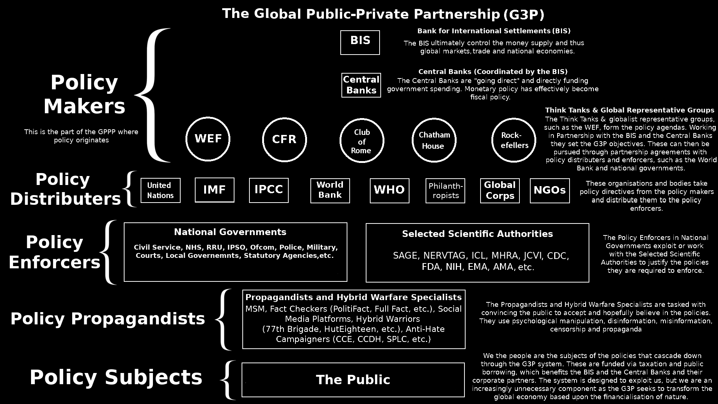

Slide 4
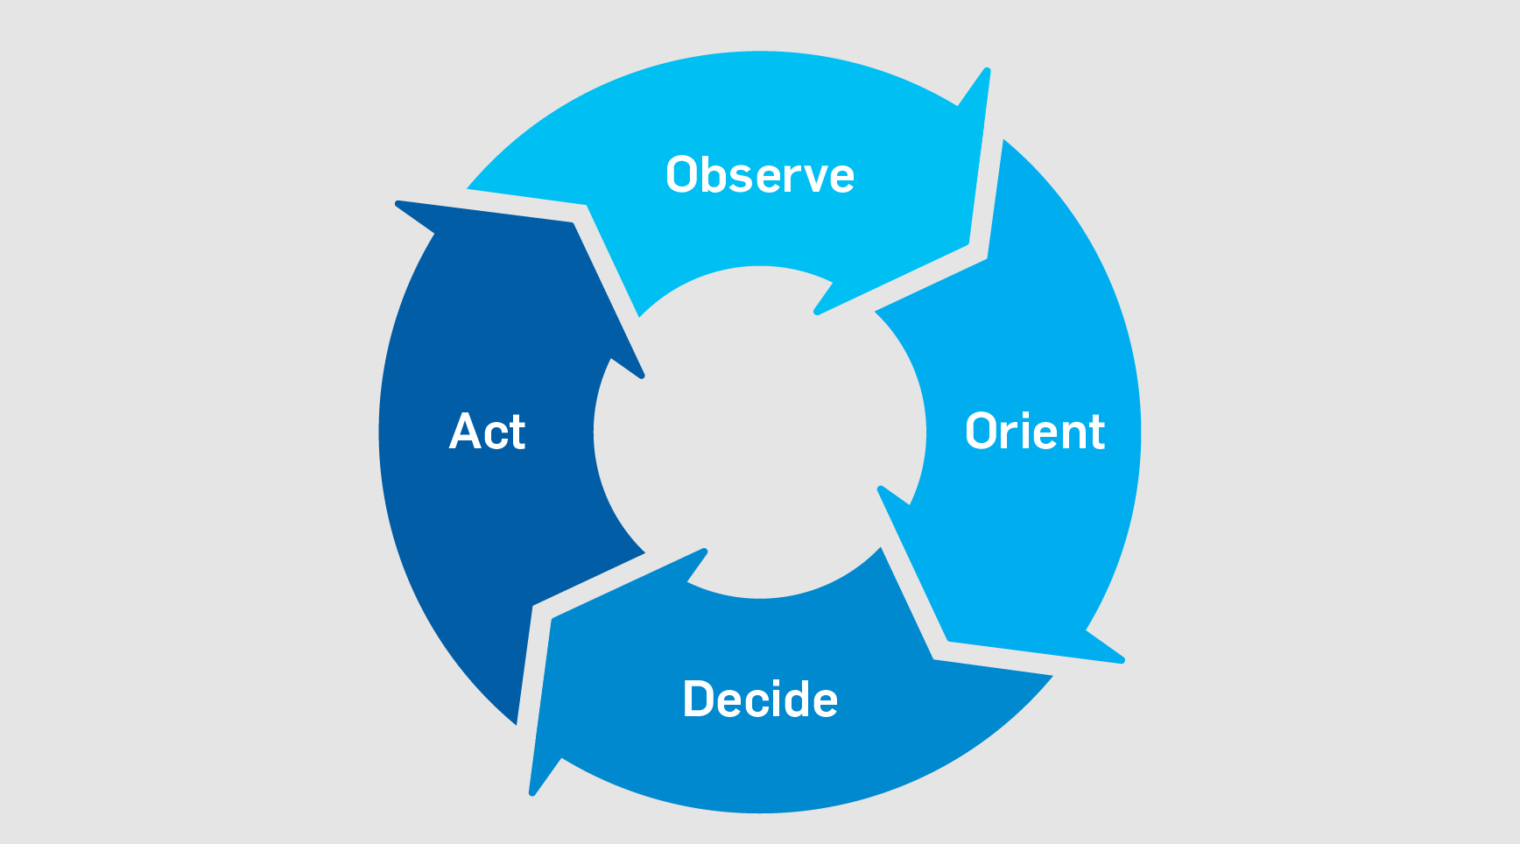

THE BIG 4
https://law.asu.edu/sites/default/files/pdf/turning-point-model-act.pdf
TURNING
POINT
ACT - 2003
1
4
WHO Pandemic Treaty
42 CFR 71-71F
2016
2
3
PUBLIC HEALTH UNDER DoD
NDAA’s ‘19, ‘21-’23

Slide 5
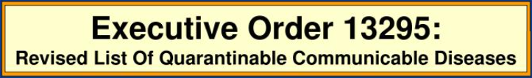
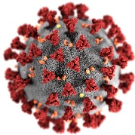
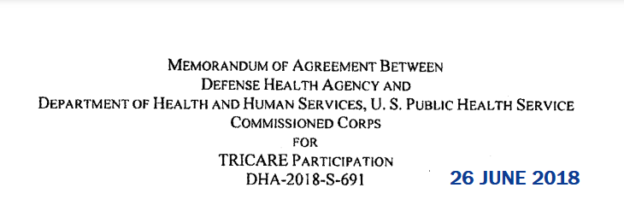
Kick Off Here
TURNING
POINT
ACT - 2003
DHA
CREATED
1976: Henry Kissinger
EXORD 13295
GW Bush
1994: Cairo Population Accords
70+ COVID 19 RELATED PATENTS CREATED
1999 | 2000 | 2001 | 2002 | 2003 | 2004 | 2005 | 2006 | 2007 | 2008 | 2009 | 2010 | 2011 | 2012 | 2013 | 2014 | 2015
WHO Pandemic Treaty
DHA
PUBLIC HEALTH DIV
70+ COVID 19 RELATED PATENTS CREATED
C-19 “A Thing”
2016 | 2017 | 2018 | 2019 | 2020 | 2021 | 2022 | 2023
WE ARE HERE!
DHA / HHS
MOA
42 CFR 71-71F
2016
2019 NDAA
Public Health
Under DHA
The 2019, ‘21, ‘22, ‘23 National Defense Authorization Acts (NDAA) directs the creation of new organizations under DHA and requests reports on the feasibility of others.
Notes:
it was Kissinger that kicked all of this off in 1976 and this particular vector of death and control was put into action in 2003; after 196 countries agreed to depopulate the planet in the 1994 Cairo population accords.
Makes emergency medical powers permanent because National Emergency Powers expire and can be revoked by congress

Slide 6
TURNING
POINT
ACT - 2003
DHA
CREATED
1976: Henry Kissinger
EXORD 13295
GW Bush
1994: Cairo Population Accords
70+ COVID 19 RELATED PATENTS CREATED
1999 | 2000 | 2001 | 2002 | 2003 | 2004 | 2005 | 2006 | 2007 | 2008 | 2009 | 2010 | 2011 | 2012 | 2013 | 2014 | 2015
WHO Pandemic Treaty
DHA
PUBLIC HEALTH DIV
70+ COVID 19 RELATED PATENTS CREATED
C-19 “A Thing”
2016 | 2017 | 2018 | 2019 | 2020 | 2021 | 2022 | 2023
DHA / HHS
MOA
42 CFR 71-71F
2016
2019 NDAA
Public Health
Under DHA
The 2019, ‘21, ‘22, ‘23 National Defense Authorization Acts (NDAA) directs the creation of new organizations under DHA and requests reports on the feasibility of others.
Notes:
it was Kissinger that kicked all of this off in 1976 and this particular vector of death and control was put into action in 2003; after 196 countries agreed to depopulate the planet in the 1994 Cairo population accords.
Makes emergency medical powers permanent because National Emergency Powers expire and can be revoked by congress

Slide 7

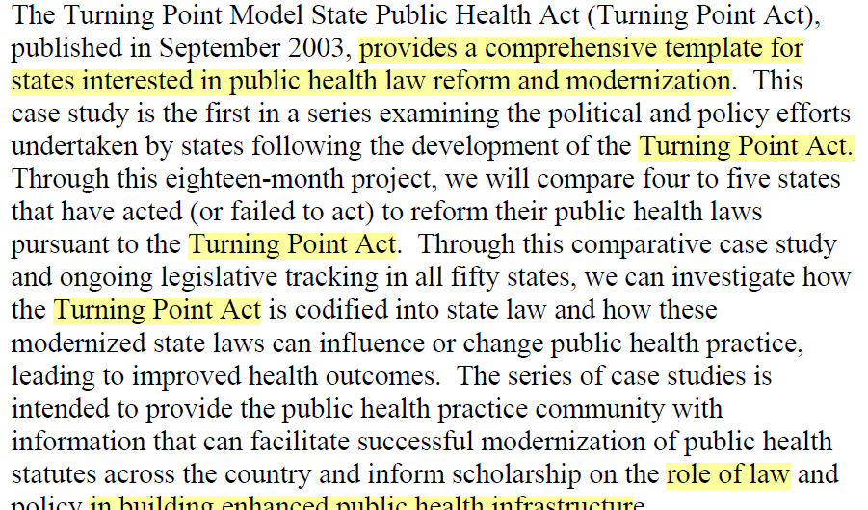
The Turning Point Model
State Public Health Act
2003
Law is an essential tool for improving public health infrastructure and outcomes; however, existing state statutory public health laws may be insufficient. Built over decades in response to various diseases/conditions, public health laws are antiquated, divergent, and confusing. The Turning Point Public Health Statute Modernization National Collaborative addressed the need for public health law reform by producing a comprehensive model state act. The Act provides scientifically, ethically, and legally sound provisions on public health infrastructure, powers, duties, and practice. This article examines (1) how statutory law can be a tool for improving the public's health, (2) existing needs for public health law reform, (3) themes and provisions of the Turning Point Act, and (4) how it is being used by public health practitioners.
Codified into state law! Producing “need” for MODEL STATE ACT!
Notes:
47 states have the bills pending – see model act and 3 states have them including Florida, Alaska and Washington
John’s Hopkins received a $76m grant to track, lobby and ensure they’re passed in all states – attachments (2)

Slide 8
TURNING
POINT
ACT - 2003
DHA
CREATED
1976: Henry Kissinger
EXORD 13295
GW Bush
1994: Cairo Population Accords
70+ COVID 19 RELATED PATENTS CREATED
1999 | 2000 | 2001 | 2002 | 2003 | 2004 | 2005 | 2006 | 2007 | 2008 | 2009 | 2010 | 2011 | 2012 | 2013 | 2014 | 2015
WHO Pandemic Treaty
DHA
PUBLIC HEALTH DIV
70+ COVID 19 RELATED PATENTS CREATED
C-19 “A Thing”
2016 | 2017 | 2018 | 2019 | 2020 | 2021 | 2022 | 2023
DHA / HHS
MOA
42 CFR 71-71F
2016
2019 NDAA
Public Health
Under DHA
The 2019, ‘21, ‘22, ‘23 National Defense Authorization Acts (NDAA) directs the creation of new organizations under DHA and requests reports on the feasibility of others.
Notes:
it was Kissinger that kicked all of this off in 1976 and this particular vector of death and control was put into action in 2003; after 196 countries agreed to depopulate the planet in the 1994 Cairo population accords.
Makes emergency medical powers permanent because National Emergency Powers expire and can be revoked by congress

Slide 9
Executive Order 13295
Section 1. Based upon the recommendation of the Secretary of Health and Human
Services (the ‘‘Secretary’’), in consultation with the Surgeon General, and for the purpose of specifying certain communicable diseases for regulations providing for the apprehension, detention, or conditional release of individuals to prevent the introduction, transmission, or spread of suspected communicable diseases, the following communicable diseases are hereby specified pursuant to section 361(b) of the Public Health Service Act:
(a) Cholera; Diphtheria; infectious Tuberculosis; Plague; Smallpox; Yellow
Fever; and Viral Hemorrhagic Fevers (Lassa, Marburg, Ebola, Crimean- Congo, South American, and others not yet isolated or named).
(b) Severe Acute Respiratory Syndrome (SARS), which is a disease associated with fever and signs and symptoms of pneumonia or other respiratory illness, is transmitted from person to person predominantly by the aerosolized or droplet route, and, if spread in the population, would have severe public health consequences.
Masks Anyone?

Slide 10

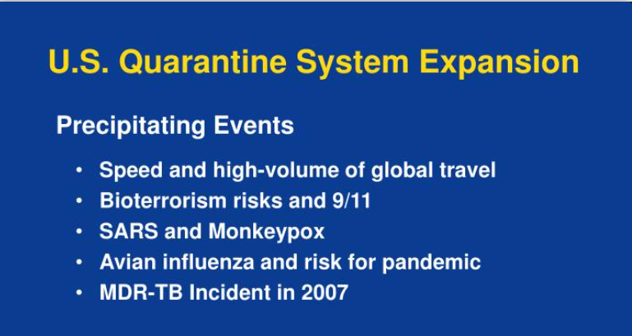
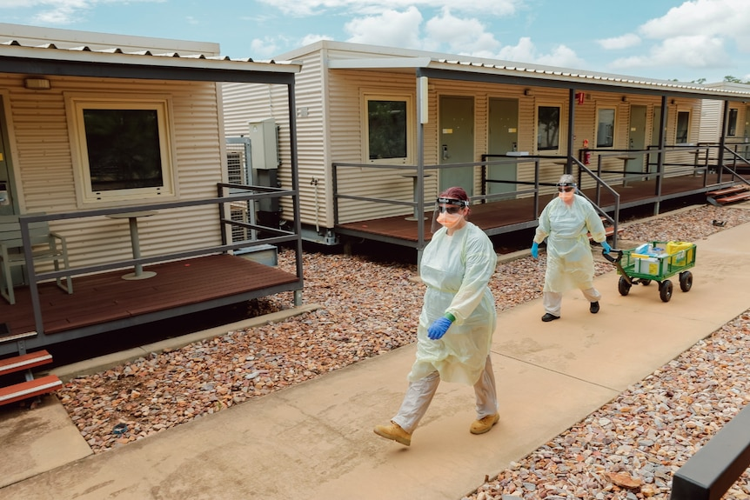
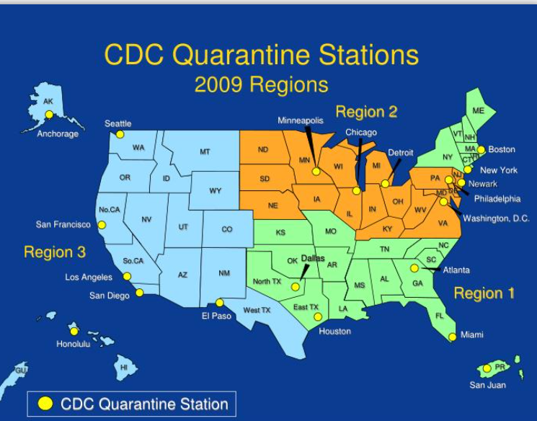
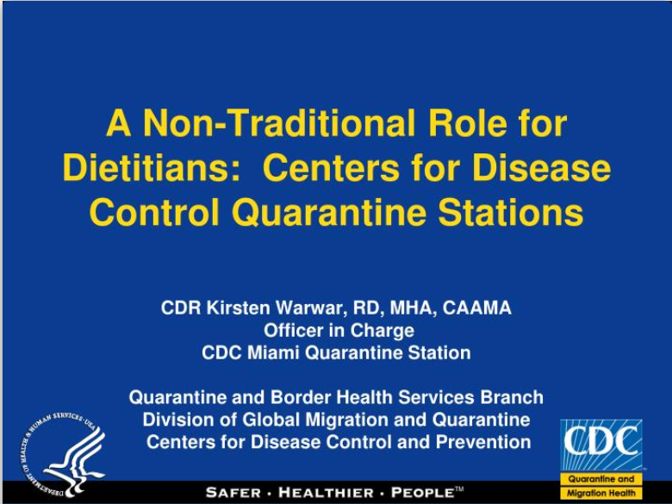
2005
EXORD 13295
GW BUSH

Slide 11
TURNING
POINT
ACT - 2003
DHA
CREATED
1976: Henry Kissinger
EXORD 13295
GW Bush
1994: Cairo Population Accords
70+ COVID 19 RELATED PATENTS CREATED
1999 | 2000 | 2001 | 2002 | 2003 | 2004 | 2005 | 2006 | 2007 | 2008 | 2009 | 2010 | 2011 | 2012 | 2013 | 2014 | 2015
WHO Pandemic Treaty
DHA
PUBLIC HEALTH DIV
70+ COVID 19 RELATED PATENTS CREATED
C-19 “A Thing”
2016 | 2017 | 2018 | 2019 | 2020 | 2021 | 2022 | 2023
DHA / HHS
MOA
42 CFR 71-71F
2016
2019 NDAA
Public Health
Under DHA
The 2019, ‘21, ‘22, ‘23 National Defense Authorization Acts (NDAA) directs the creation of new organizations under DHA and requests reports on the feasibility of others.
Notes:
it was Kissinger that kicked all of this off in 1976 and this particular vector of death and control was put into action in 2003; after 196 countries agreed to depopulate the planet in the 1994 Cairo population accords.
Makes emergency medical powers permanent because National Emergency Powers expire and can be revoked by congress

Slide 12
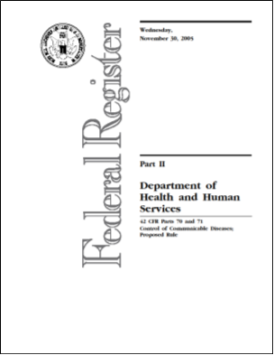
42 CODE of FEDERAL REGULATIONS (CFR)
Parts 70 and 71 (federal) is put in place in 2016
(Just as the pathogen is getting close to release)
2016
The Centers for Disease Control and Prevention (CDC), within the Department of Health and Human Services (HHS), is issuing this final rule (FR) to amend its regulations governing its domestic (interstate) and foreign quarantine regulations to best protect the public health of the United States. These amendments have been made to
aid public health responses to outbreaks of new or re-emerging communicable diseases and to accord due process to individuals subject to Federal public health orders.
In response to public comment received, the updated provisions in this final rule clarify various safeguards to prevent the importation and spread of communicable diseases affecting human health into the United States and interstate.
Bottom Line: Once these acts are in play the necessity for Nat’l Emerg. Powers not required!

Slide 13
TURNING
POINT
ACT - 2003
DHA
CREATED
1976: Henry Kissinger
EXORD 13295
GW Bush
1994: Cairo Population Accords
70+ COVID 19 RELATED PATENTS CREATED
1999 | 2000 | 2001 | 2002 | 2003 | 2004 | 2005 | 2006 | 2007 | 2008 | 2009 | 2010 | 2011 | 2012 | 2013 | 2014 | 2015
WHO Pandemic Treaty
DHA
PUBLIC HEALTH DIV
70+ COVID 19 RELATED PATENTS CREATED
C-19 “A Thing”
2016 | 2017 | 2018 | 2019 | 2020 | 2021 | 2022 | 2023
DHA / HHS
MOA
42 CFR 71-71F
2016
2019 NDAA
Public Health
Under DHA
The 2019, ‘21, ‘22, ‘23 National Defense Authorization Acts (NDAA) directs the creation of new organizations under DHA and requests reports on the feasibility of others.
Notes:
it was Kissinger that kicked all of this off in 1976 and this particular vector of death and control was put into action in 2003; after 196 countries agreed to depopulate the planet in the 1994 Cairo population accords.
Makes emergency medical powers permanent because National Emergency Powers expire and can be revoked by congress

Slide 14
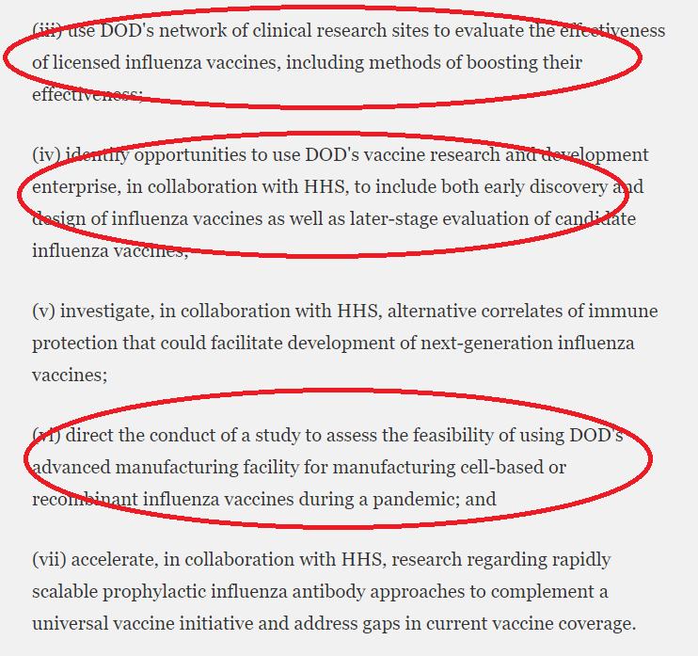
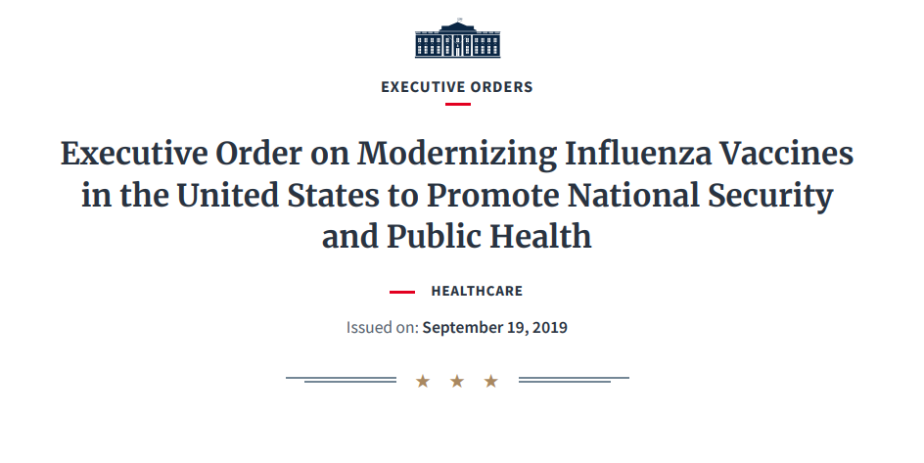
2019
EXORD 13887
DJ TRUMP
RIGHT BEFORE RELEASE
of SARS CoV-2!
https://www.federalregister.gov/documents/2019/09/24/2019-20804/modernizing-influenza-vaccines-in-the-united-states-to-promote-national-security-and-public-health
Notes:
the monsters who planned this shit couldn’t get it through before Trump after trying to get others to agree it. Apparently the Vatican (church) wouldn’t allow it due to the gene modification technology – which they had in its current state of the art since 2003 – imagine what they really have. So, along comes Trump, who gleefully signs it, brags about it and then immediately after comes the attack with the bioweapon that no one will call a bioweapon because it would be an act of war requiring a military response.

Slide 15
Executive Order 13295
Sec. 2. Policy. It is the policy of the United States to modernize the domestic influenza vaccine enterprise to be highly responsive, flexible, scalable, and more effective at preventing the spread of influenza viruses. This is a public health and national security priority, as influenza has the potential to significantly harm the United States and our interests, including through large-scale illness and death, disruption to military operations, and damage to the economy. This order directs actions to reduce the United States' reliance on egg-based influenza vaccine production; to expand domestic capacity of alternative methods that allow more agile and rapid responses to emerging influenza viruses; to advance the development of new, broadly protective vaccine candidates that provide more effective and longer lasting immunities; and to support the promotion of increased influenza vaccine immunization across recommended populations.
Sec. 3. National Influenza Vaccine Task Force. (a) There is hereby established a National Influenza Vaccine Task Force (Task Force). The Task Force shall identify actions to achieve the objectives identified in section 2 of this order and monitor and report on the implementation and results of those actions. The Task Force shall be co-chaired by the Secretary of Defense and the Secretary of Health and Human Services, or their designees
mRNA Genetic Engineering Anyone?

Slide 16
TURNING
POINT
ACT - 2003
DHA
CREATED
1976: Henry Kissinger
EXORD 13295
GW Bush
1994: Cairo Population Accords
70+ COVID 19 RELATED PATENTS CREATED
1999 | 2000 | 2001 | 2002 | 2003 | 2004 | 2005 | 2006 | 2007 | 2008 | 2009 | 2010 | 2011 | 2012 | 2013 | 2014 | 2015
WHO Pandemic Treaty
DHA
PUBLIC HEALTH DIV
70+ COVID 19 RELATED PATENTS CREATED
C-19 “A Thing”
2016 | 2017 | 2018 | 2019 | 2020 | 2021 | 2022 | 2023
DHA / HHS
MOA
42 CFR 71-71F
2016
2019 NDAA
Public Health
Under DHA
The 2019, ‘21, ‘22, ‘23 National Defense Authorization Acts (NDAA) directs the creation of new organizations under DHA and requests reports on the feasibility of others.
Notes:
it was Kissinger that kicked all of this off in 1976 and this particular vector of death and control was put into action in 2003; after 196 countries agreed to depopulate the planet in the 1994 Cairo population accords.
Makes emergency medical powers permanent because National Emergency Powers expire and can be revoked by congress

Slide 17

Public Health under the DOD starting with a consolidation of DOD health powers with very broad application in any emergency situation. NDAA 2019, 2021, 2022 and 2023.
DoD
MHS
DHA
Public Health Division
Notes:
The Nongoverning Governing Bodies
NDAA 2021, 2022 & 2023 moves public health under Defense Health Agency who committed to WHO to cooperate globally
6,000 uniformed military public health staff already

Slide 18
TURNING
POINT
ACT - 2003
DHA
CREATED
1976: Henry Kissinger
EXORD 13295
GW Bush
1994: Cairo Population Accords
70+ COVID 19 RELATED PATENTS CREATED
1999 | 2000 | 2001 | 2002 | 2003 | 2004 | 2005 | 2006 | 2007 | 2008 | 2009 | 2010 | 2011 | 2012 | 2013 | 2014 | 2015
WHO Pandemic Treaty
DHA
PUBLIC HEALTH DIV
70+ COVID 19 RELATED PATENTS CREATED
C-19 “A Thing”
2016 | 2017 | 2018 | 2019 | 2020 | 2021 | 2022 | 2023
DHA / HHS
MOA
42 CFR 71-71F
2016
2019 NDAA
Public Health
Under DHA
The 2019, ‘21, ‘22, ‘23 National Defense Authorization Acts (NDAA) directs the creation of new organizations under DHA and requests reports on the feasibility of others.
Notes:
it was Kissinger that kicked all of this off in 1976 and this particular vector of death and control was put into action in 2003; after 196 countries agreed to depopulate the planet in the 1994 Cairo population accords.
Makes emergency medical powers permanent because National Emergency Powers expire and can be revoked by congress

Slide 19
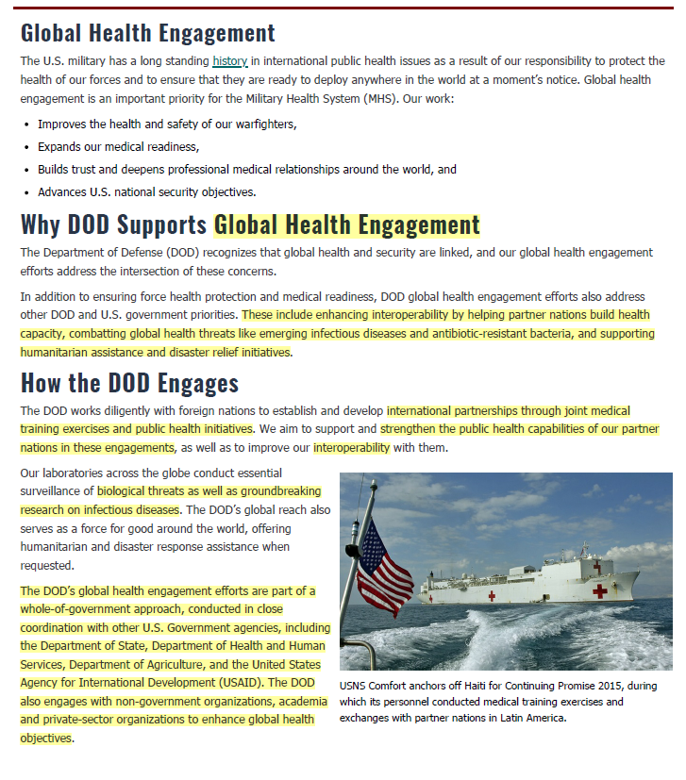
It ends with the Military following WHO treaty induced mandates to enforce the provisions, locally, state and federally, in relation to compulsory shots, quarantine, execution, etc.
“Global Health Engagement”
Partners in a
“Whole-of-Government” Approach
DoS
HHS
Dept of Agriculture
USAID (CIA)
NGO’s (US and Foreign)
Academia (UNC)
Private Sector (US and Foreign)
  Pfizer, Moderna, BIO-ENTECH
  Unissant ($$$ / OPSEC Breach)
https://nitaac.nih.gov/gwacs/cio-sp3-small-business/contract-holder/unissant-inc
Notes:
However, the Pandemic Treaty will not allow individuals to rely on their own physical, spiritual, and intellectual faculties in order to achieve their own well-being. Instead, it will impose treatments and vaccination on individuals against their own will, thereby violating bodily freedom on a global scale. History is a testament to the fact that violating bodily freedom leads to slavery and retrogression in society.
The Pandemic Treaty will also give the WHO the authority to issue dictates within the private spheres of individuals and to exercise control over their social and public lives, the institutions of their society, and their governments, all in the name of public health. In doing so, it will suppress civil liberties, economic freedom, positive freedom (freedom to), and negative freedom (freedom from). All these forms of freedom are intended to be constructive forces in society that contribute to the achievement of social progress. Once these freedoms are stifled, the foundations of progress and advancement also vanish.
Sec. Austin already approved use of force for shots and quarantine

Slide 20
TURNING
POINT
ACT - 2003
DHA
CREATED
1976: Henry Kissinger
EXORD 13295
GW Bush
1994: Cairo Population Accords
70+ COVID 19 RELATED PATENTS CREATED
1999 | 2000 | 2001 | 2002 | 2003 | 2004 | 2005 | 2006 | 2007 | 2008 | 2009 | 2010 | 2011 | 2012 | 2013 | 2014 | 2015
WHO Pandemic Treaty
DHA
PUBLIC HEALTH DIV
70+ COVID 19 RELATED PATENTS CREATED
C-19 “A Thing”
2016 | 2017 | 2018 | 2019 | 2020 | 2021 | 2022 | 2023
WE ARE HERE!
DHA / HHS
MOA
42 CFR 71-71F
2016
2019 NDAA
Public Health
Under DHA
The 2019, ‘21, ‘22, ‘23 National Defense Authorization Acts (NDAA) directs the creation of new organizations under DHA and requests reports on the feasibility of others.
Notes:
it was Kissinger that kicked all of this off in 1976 and this particular vector of death and control was put into action in 2003; after 196 countries agreed to depopulate the planet in the 1994 Cairo population accords.
Makes emergency medical powers permanent because National Emergency Powers expire and can be revoked by congress

Slide 21
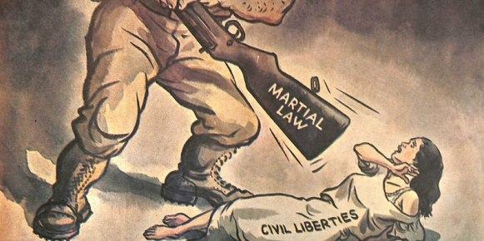
Nothing to stop military medical martial law globally other than us – the world is at risk!
Notes:
Nothing to stop military medical martial law globally other than us – the world is at risk

Slide 22

FOLLOW ME IF YOU WANT TO LIVE!

